Slide 1


Slide 2

The book
2016
3 decades since the birth of the internet
tech forces that will shape the next 30 years
Notes:
A few years ago, I read this book called "the inevitable", by Kevin Kelly (the founding editor of Wired Magazine). Kevin describes 12 technological forces that will shape the next 30 years, based on what he saw over the last 3 decades since the birth of the internet.

Slide 3
The forces
Sharing
• Tracking
• Accessing
• Beginning
Screening
• Questioning
• Remixing
• Flowing
Cognifying
• Becoming
• Interacting
• Filtering
What’s taking us so long?
🤔
Notes:
We could categorize these forces into 3 main pillars: SHARING (in a future where all humans and machines will be connected in an ecosystem supported by the Internet), SCREENING (in the sense that, one day, humans will interact with screens everywhere), and COGNIFYING (when any thing NOT interactive, will be considered broken). I remember how excited I got with this positive view of the future of humankind, and how I found myself asking: "what's takings us so long?"

Slide 4
The forces
Cognifying
• Becoming
• Interacting
• Filtering
Screening
• Questioning
• Remixing
• Flowing
Sharing
• Tracking
• Accessing
• Beginning
What’s taking us so long?
🤔
Notes:
We could categorize these forces into 3 main pillars: cognifying (meaning that, in the future, something that is NOT interactive will be considered broken), screening (in the sense that screens will be everywhere), and sharing (envisioning that one day all humans and machines will be connected to one another). I remember loving this positive view of the future of humankind, and finding myself asking "what's takings us so long?"

Slide 5
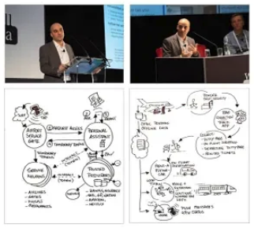
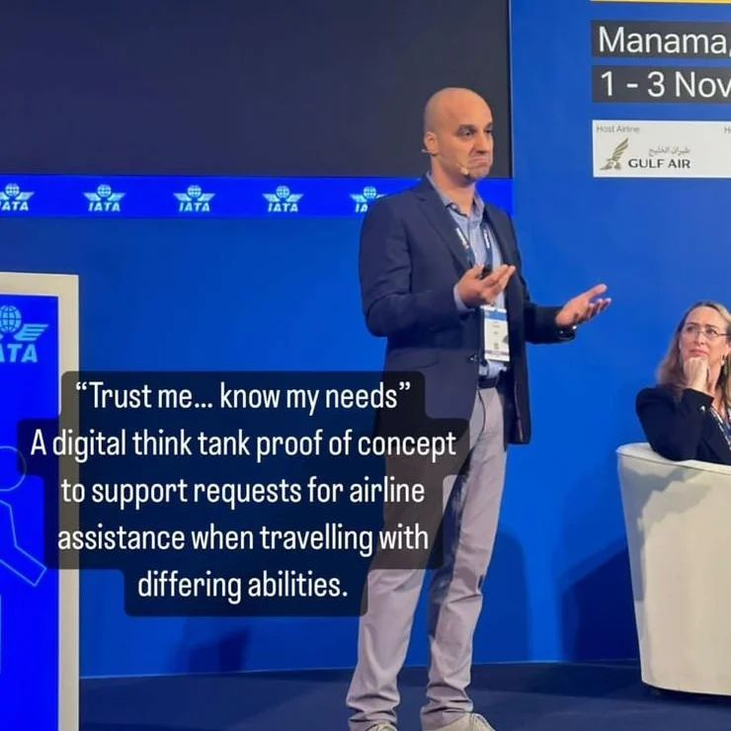
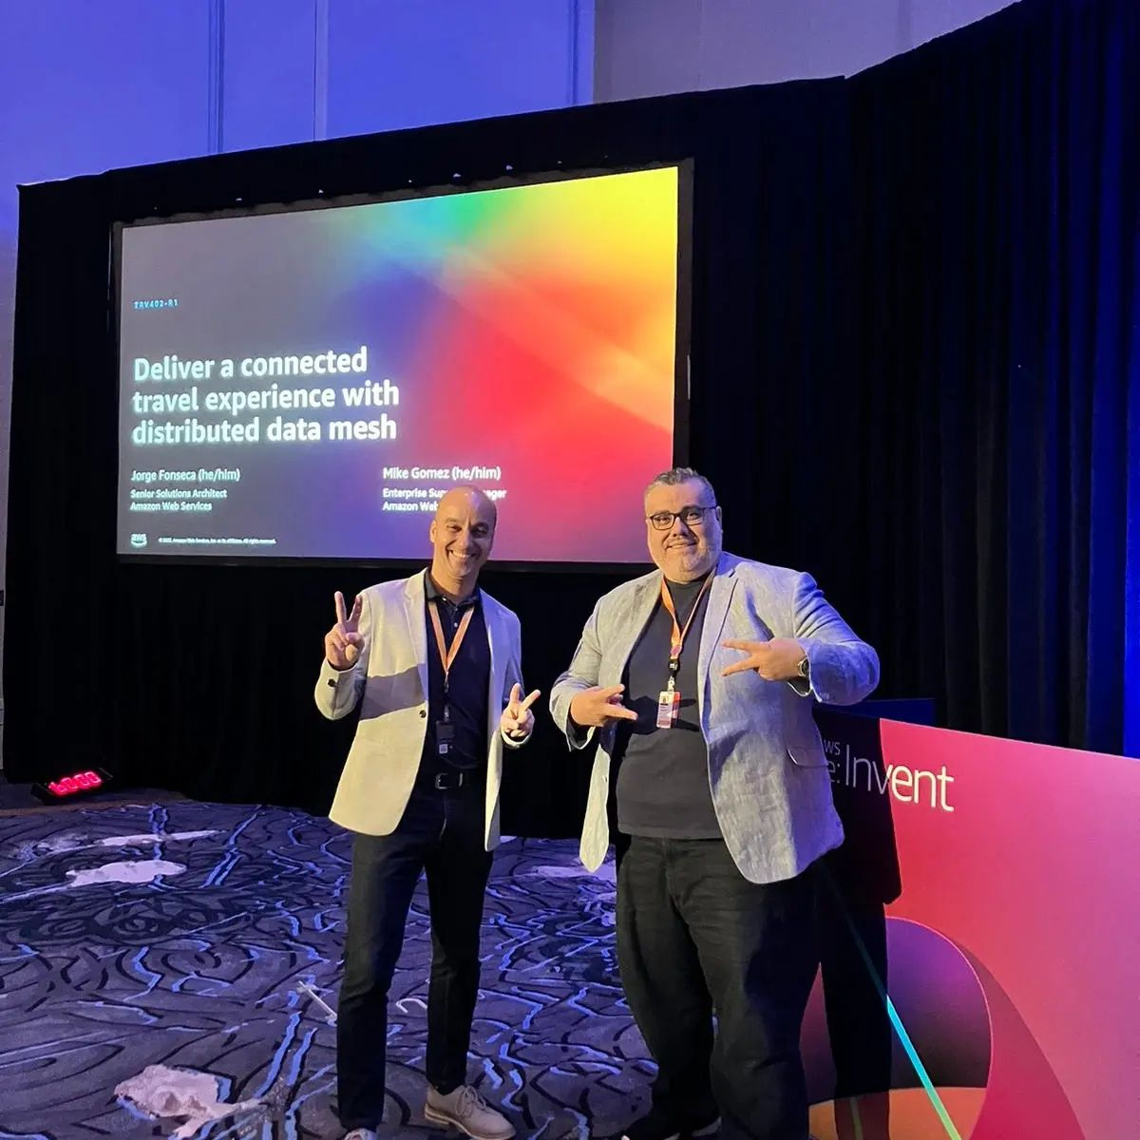
About the past
2018 @ London, UK Enterprise Cloud Comp. conf.
The future of customer experience in commercial aviation
2022 @ Manama, Bahrain World Passenger Symposium
IATA Digital Think Tank Trust me, know my needs W3C DIDs, VCs, DIDcomm
2022 @ Las Vegas, USA AWS re:Invent
Deliver a connected travel experience with distributed data mesh
Notes:
Over the following years, I had the opportunity to work on these topics with brilliant colleagues from the airline industry. We simulated multiple customer use-cases, built state-of-art proofs-of-concept for global conferences, and spoke with many cutting-edge organizations around the world.

Slide 6
About the future
Share with trust
Domain trust framework Decentralized backbone
Remix user screens
UI primitive parts Session dialogs
Cognify everything
One tap to connect One tap interactions
Notes:
What resulted from this effort, is what I will share with you in this session. I will describe a framework for decentralized data sharing; I'll explain how to integrate it with digital wallets and super apps; and I'll explain how to extend it to the physical world of objects and spaces.

Slide 7
About the future
Cognify everything
One tap to connect One tap interactions
Remix user screens
UI primitive parts Session dialogs
Share with trust
Domain trust framework Decentralized backbone
Notes:
What resulted from this work, is a domain trust framework that addresses the 3 technological pillars that we saw earlier: 1) the ability to connect and cognify nearly everything, 2) the ability to push the user experience to digital wallets and s

Slide 8



Agenda
Sharing
Screening
Cognifying
Why?
How?
Where?
Notes:
If you think that's too much content in one go, then you are probably right. To make it easier to digest, we'll break the session into 3 parts. First, we will work backwards from the cognifying goal, to understand why we need all 3 pillars. Then, we will see how the building blocks connect with one another from the ground up. And finally, I'll share with you the hyper links to the specifications and source code that you need to integrate your applications into this ecosystem TODAY.

Slide 9
Agenda
Cognifying
Screening
Sharing
Why?
How?
Where?

Slide 10
Connect and cognify nearly every thing, place, and service
Pitch
Jorge Fonseca (he/him)
Senior Solutions Architect
Amazon Web Services
Notes:
That said, come along with me in this journey of connect and cognify nearly every thing, place, and service. See you there.

